Slide 1
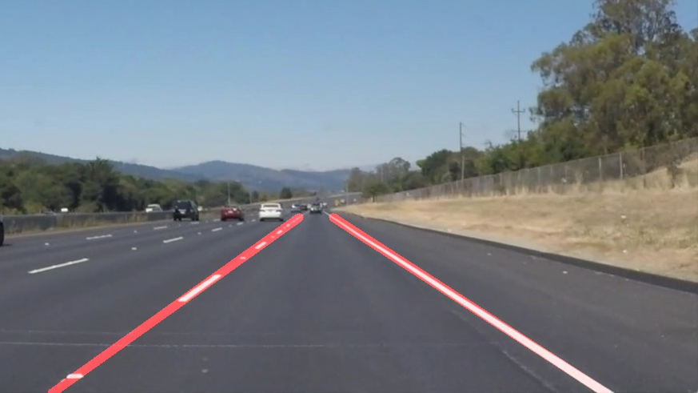
Finding Lane Lines on the Road

Slide 2
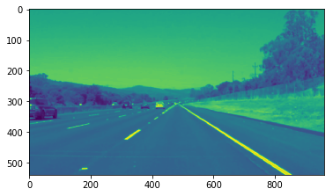
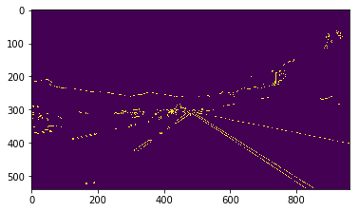
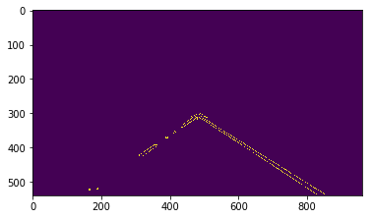
PIPELINE
My pipeline consisted of 6 steps.
The image is first converted to grayscale image.
Next we apply gaussian smoothing of kernel size 5 to remove noise and reduce detail of the image.
Then, we apply canny edge detection to find the different edges of each details in the image.
After the edge detection, we narrow our area of interest by limiting to the region that includes the lanes lines (edges) that the car is following. For this we select a triangle region with apex that is at the center of the image and the base endpoints at the sides and pass it onto the cv.fillpoly function and apply ignore mask to region outside the triangle.

Slide 3
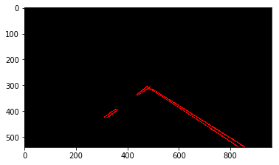
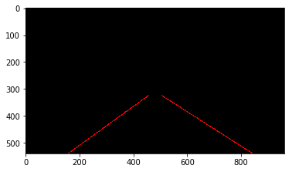
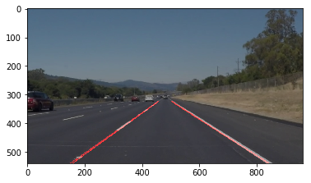
PIPELINE
Next we define Hough transform parameters and run Hough Transform on masked edge-detected image to detect the lane lines. This gives us line segments where the white markers are not continuous. To connect these segment lines, we modify the draw_line() to extrapolate the segments. For this we the classify the segments to left or right by calculating their slopes along with the y-intercepts. We use the median to get the midpoint of the slopes and intercepts. Using this information and the vertices we defined for the region of interest, we construct the full lane lines by using the formula y = mx +c where m is the slope and c the intercept.
Finally the extrapolated line segments image is combined with the original image to show the lane lines.

Slide 4
SHORTCOMINGS
The algorithm relies on how the lane lines are fed into the camera. A change in the camera angle or location has a potential to cause this algorithm to fail to accurately detect lane lines.
Our choice of vertices is not good when the lanes line form steep curves. The edges detected from the curved lines when extrapolated by the draw_line causes the lane lines to be drawn inaccurately since we fixed the apex to be at the center of the image.
It is also susceptible to failure if the visibility of the lane lines is reduced due to external factors like weather, time of the day, traffic etc.

Slide 5
IMPROVEMENTS
One possible improvement is to create a mask to ignore everything except for yellow or white colors so that we can reduce to the information that we are interested.
We could use a trapezoid instead of rigid triangle for region of interest which may compensate for steep curves or we should use the radius of the curve to draw curved lines instead of extrapolating straight line segments.
We can train with different scenarios of limited visibility of the lane lines to tune the hyper-parameters and make our algorithm to work under various conditions.

